Slide 1
IMS PROJECT
NEEL DUDHIA

Slide 2
Introduction

Slide 3
What technologies have been used
Back end development :JAVA
Version Control: GITHUB
Build management tool: MAVEN
Sprint& Scrum planning: JIRA
Unit testing: JUNIT
Database management system: MySQL

Slide 4
Risk Assesement
Description | Evaluation | Likelihood | Responsibilty | Impact Level | Response | Control Measures
1.Single point of failure | One small part of the system could fail leaving the rest of the system disabled | Medium | Developers | HIGH | Run debugging checks to find the cause of the failure | Run regular unit and integration tests reduce likelihood of failure
2. Power Cuts | All system offline | Low | Building Maintenance | HIGH | Try to find cause of power cuts and work quickly to repair it | Install backup generators at the facility to reduce time wasted
3. Unauthorised Interference | People with unauthorised access can interfere with data and manipulate it | Low | Developers | MEDIUM | Try to find wher the unauthorised access originated from and shut down the connection | Ensure permisions are monitored regularly Monitor Firewall
4. Flooding | Flooding can lead to destruction of servers and infrastructure | Low | None | HIGH | Evacuate as soon as possible as there are a high amout of electrical hazards | Keep the servers on a higher floor. Ensure there is sufficient drainage around building
5. Project Risk | Scope creep can lead to projects losing scope and being overloaded by sprints. Can lead to uncomplete tasks and not adhering to the MVP | Medium | Developers | MEDIUM | Analyse changes to a project and how it impacts the end product. Thus allowing for effective division of tasks and priorities | Daily Scrum AGILE practices

Slide 5
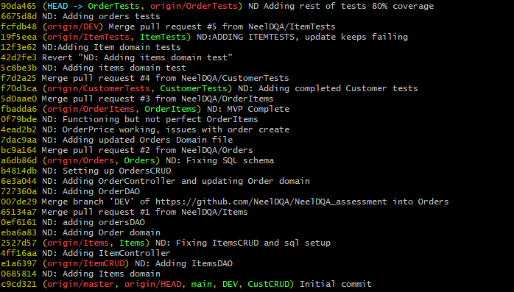
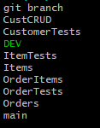
Versioning

Slide 6
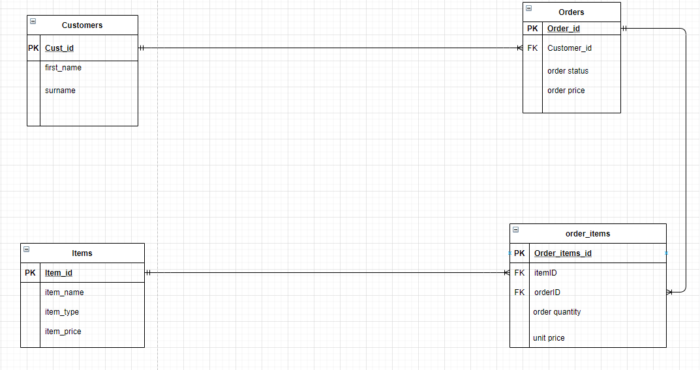
ERD DIAGRAM

Slide 7
Testing
Unit Testing
Aiming for 80% coverage

Slide 8
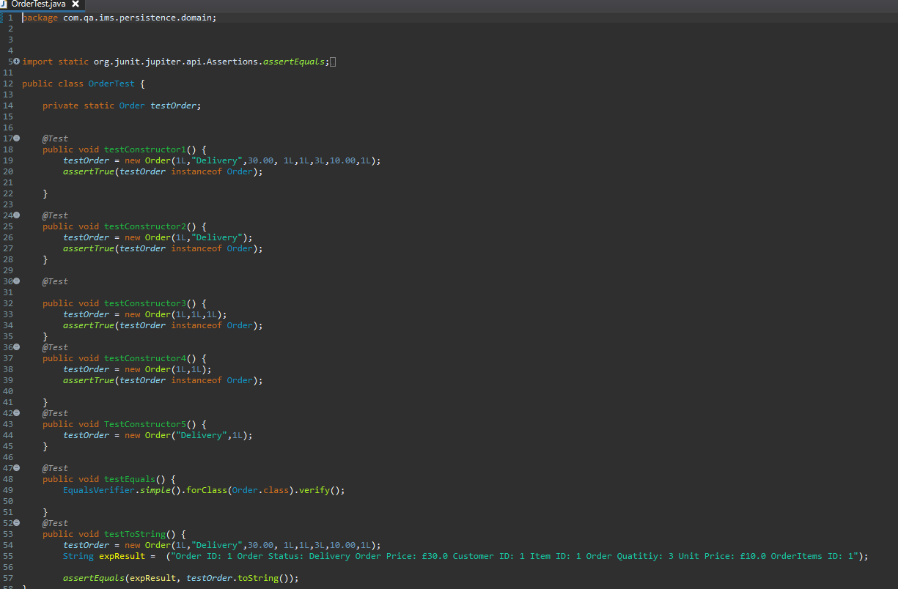
Example Domain test

Slide 9
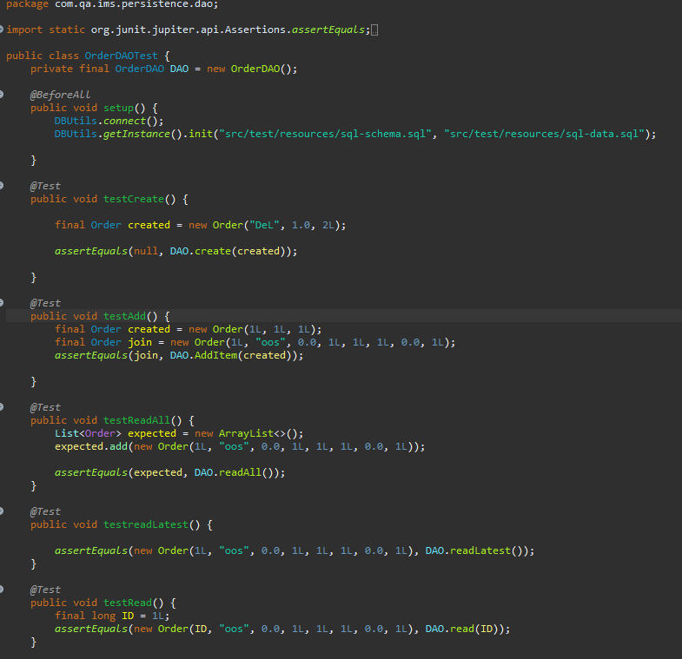
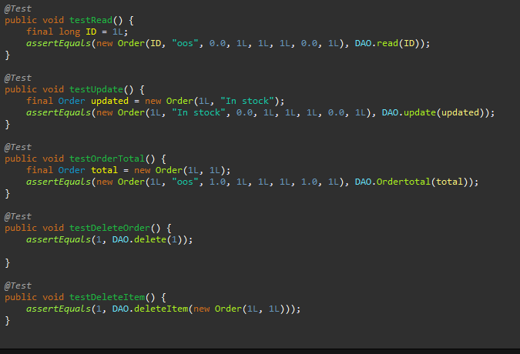
Example DAO test

Slide 10
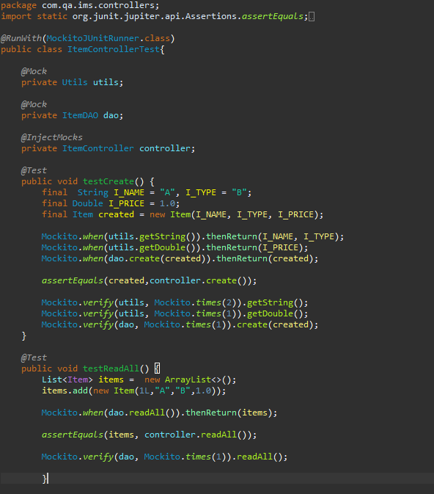
Mockito
Notes:
Mockito allows us to ensure we are doing unit tests when we are calling in multiple classes. It allows us to simulate the database without having to actually connect to it, ensuring that only the lass is being tested.
As well as this we can control what the expected results will be making it easier to test. For example following along this code. We keep track of how many times each mock object is used by using .verify so

Slide 11
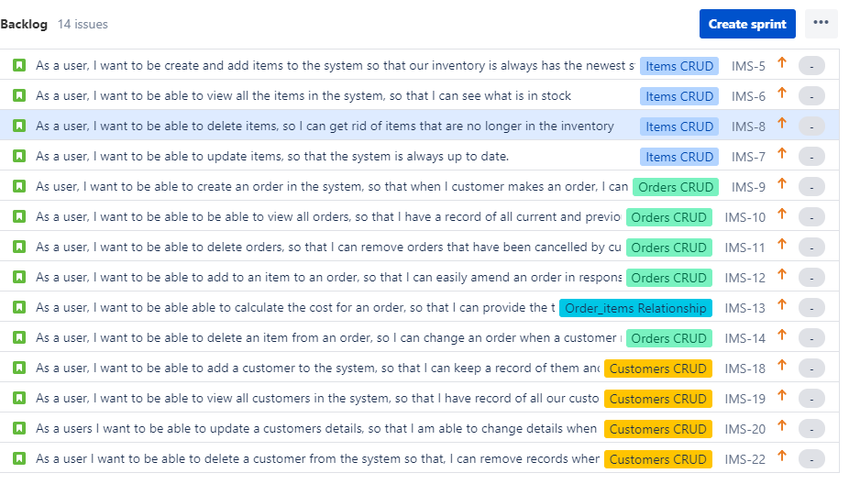
SPRINT BACKLOG

Slide 12
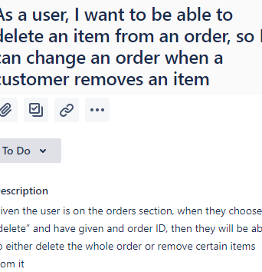
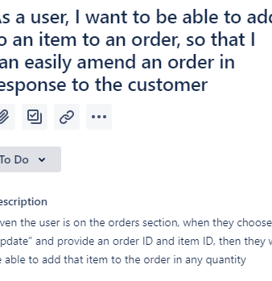
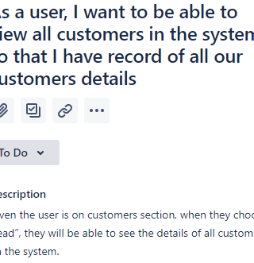
Acceptance Criteria

Slide 13
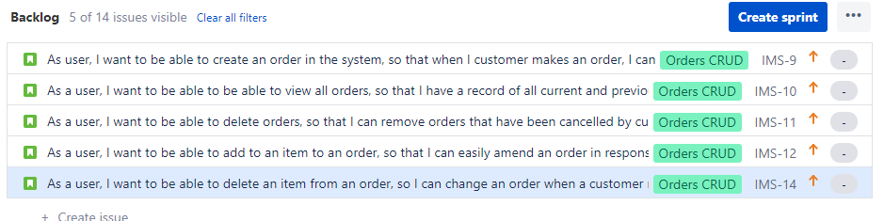
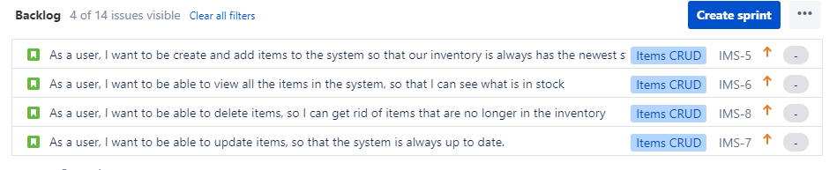
EPICS

Slide 14
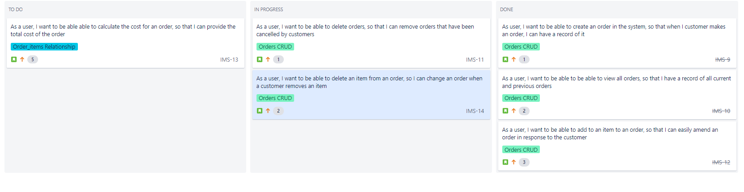
SPRINT EXAMPLE

Slide 15
SPRINT REVIEW & RETROSPECTIVE
Good:
All user stories were complete
Completed over 80% testing coverage
Things for the future:
Implementing a more friendly user interface
Can create a login page for more secure access

